Slide 1


CUEBIQ Turnover Analysis Senior Challenge
Challenger
Antonio Castiglione

Slide 2
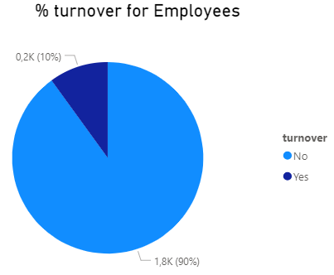
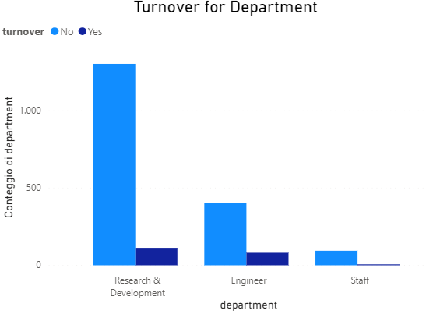
Why has the turnover increased in Facial Inc.?
The HR department is required to find out the reasons behind this phenomenon. The employee turnover is a costly problem for companies and often is difficult replacing an employee with good skills.
We have data from 3 departments, namely Research & Development, Engineer and Staff.

Slide 3




My approach to analyze the problem
Analyze the data provided by Facial Inc. in the dataset called datasetV2.
Understand the key indicators of an employee leaving the company.
Understand likelihood of an active employee leaving the company.
Find the good policies or strategies to improve employee retention.
Used Tools

Slide 4
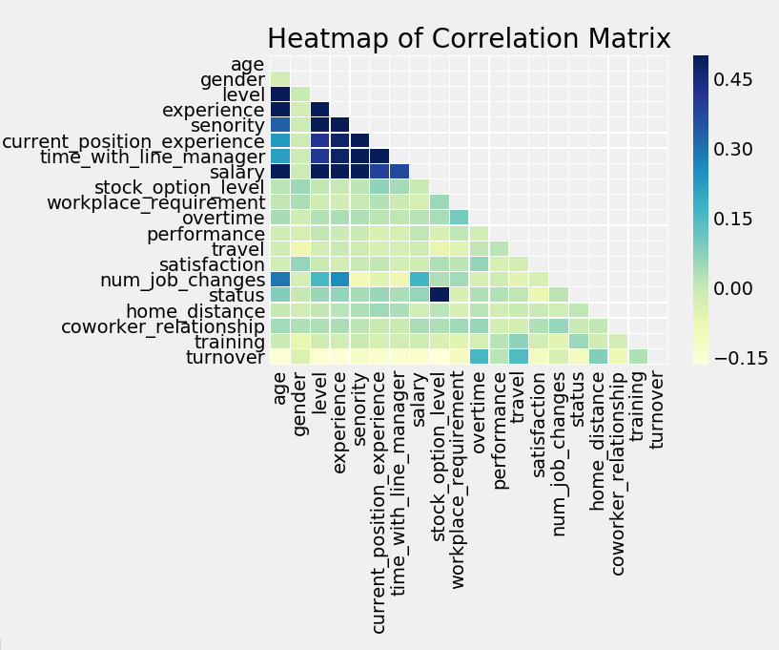
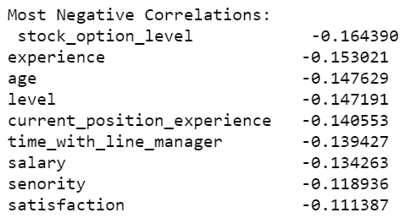
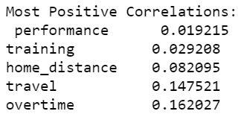
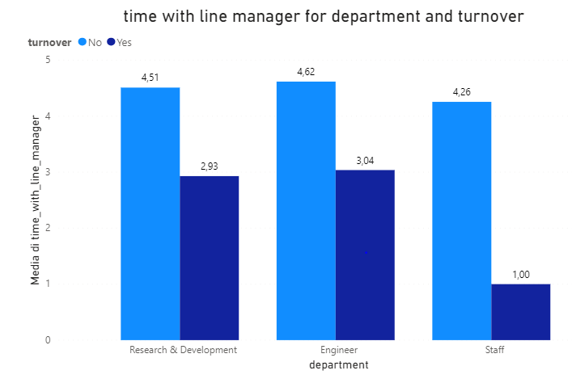
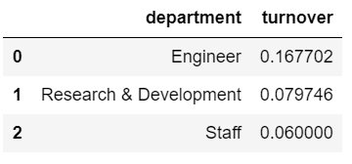
Data Analysis
Correlation Matrix show positive and negative correlation between the variables. We analyze the correlation with Turnover (the target variable).
Younger employees are not very assisted by their line manager
Engineer Department on average it has more turnover
There is a correlation between this 2 observations

Slide 5
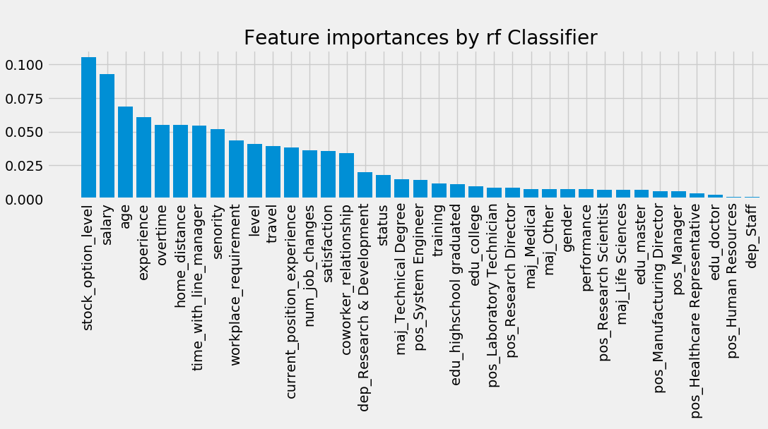
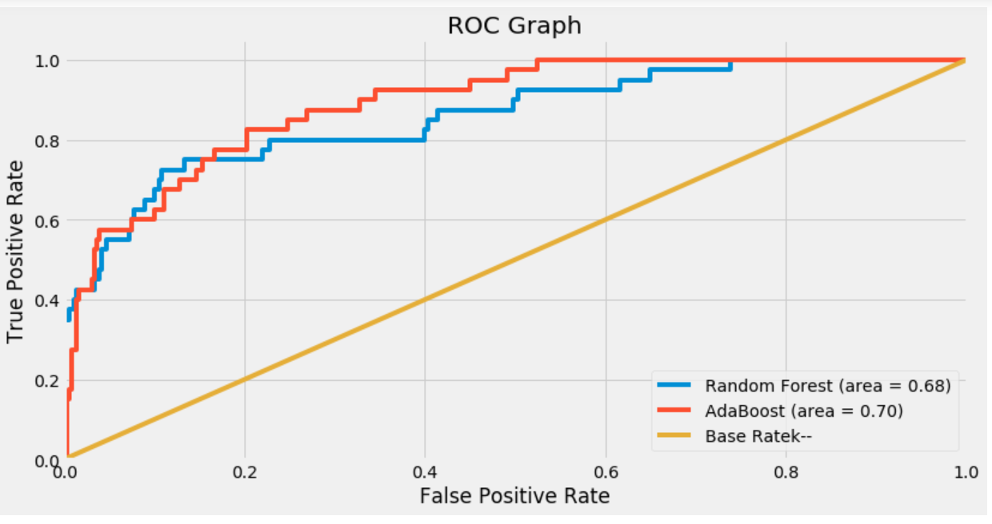
Machine Learning Analysis
AdaBoost accuracy is 0.92
Random Forest accuracy is 0.93
The analysis through Machine Learning, as far as features are concerned, has confirmed, in broad terms, what was found through the correlation matrix.
In Roc Curve we can be assigning a Turnover Probability based on the predicted label such that:
Employees with label < 0.6 have low probability to leave Facial.Inc.
Employees with label between 0.6 and 0.8 have medium probability to leave Facial.Inc.
Employees with label > 0.8 have high probability to leave Facial.Inc.

Slide 6
Reasons of turnover in Facial Inc.
Age: Employees in relatively younger (under 35) and single are more likely to leave.
Salary: Employees with salary under 4800 are more likely to leave and have a Level more low (1,62) than other employees that not leaves the company.
Stok Option Level :Having a low level of stock options does not discourage employees from leaving the company.
Experience: Whoever leaves has less experience on average, because younger, it means that Facial Inc. neglects its employees with a junior profile.
Time with Line Manager: A large number of leavers leave before 3 years with Line Managers. We need investigate who is the Manager that have the largest numbers of employees resigning over the past year.
Over Time and Home Distance: People who work overtime and live further from home are more likelty to leave the company.
Senority: Employees who have senority, under 5 years, are more likely to leave the company, this featurs is closely related to others such as age, experience, stock options and salary.
Satisfaction: Obviously satisfaction is an important index and is closely connected to the other variables, it must be said that even in those who remain it was not found on average not a great satisfaction, but probably for other factors prefers to remain in Facial Inc.

Slide 7
Conclusions
First step by Facial Inc. would be to motivate and give attention to the most junior employees, focusing on how to make life in the company more attractive and enjoyable, not to lose these resources.
face-to-face meetings between a HR representative and employees can be initiated for medium- and high-risk employees to discuss work conditions in each department.
Also to question the line manager with more turnover( for example in Engineer Department that has the highest average turnover) to understand his difficulties in relating to the employees most at risk based on the features analysed.

